Slide 1
Real Time Face Mask Detection Using Deep Learning
Team members
Vengiswaran.A.L 211418104332
Valaparla Akhil Tagore 211418104330
Mritesh.M 211418104324

Slide 2
Abstract
After the breakout of the worldwide pandemic COVID-19, there arises a severe need of protection mechanisms, face mask being the primary one.
The basic aim of the project is to detect the presence of a face mask on human faces on live streaming video as well as on images. We have used deep learning to develop our face detector model. The architecture used for the object detection purpose is Single Shot Detector (SSD) because of its good performance accuracy and high speed.
Alongside this, we have used basic concepts of transfer learning in neural networks to finally output presence or absence of a face mask in an image or a video stream. Experimental results show that our model performs well on the test data with 100% and 99% precision and recall, respectively.

Slide 3
Tools used
Deep learning
Phyton
Torch
TensorFlow

Slide 4
List Of Modules
Dataset Training
Develop face mask detector module
Apply face mask detector module

Slide 5
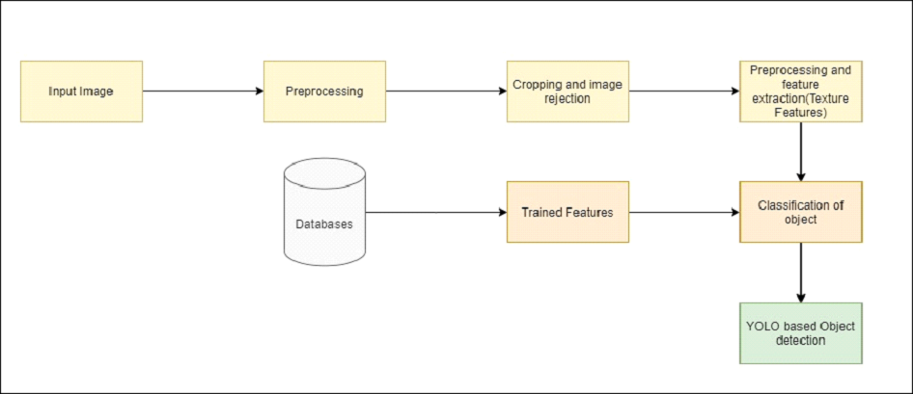
Architecture Diagram

Slide 6
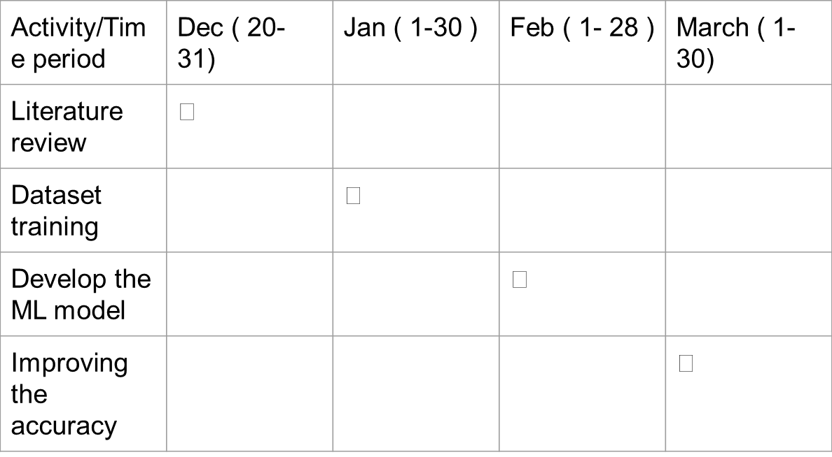
Timeline Chart

Slide 7
Thank you

